Slide 1
Unit 1
Data Types & Collection

Slide 2
Out line
Types of Data
Attributes & Measurements
Types of Data Sets
Data Quality
Data Measurement and Data Collection Issues

Slide 3
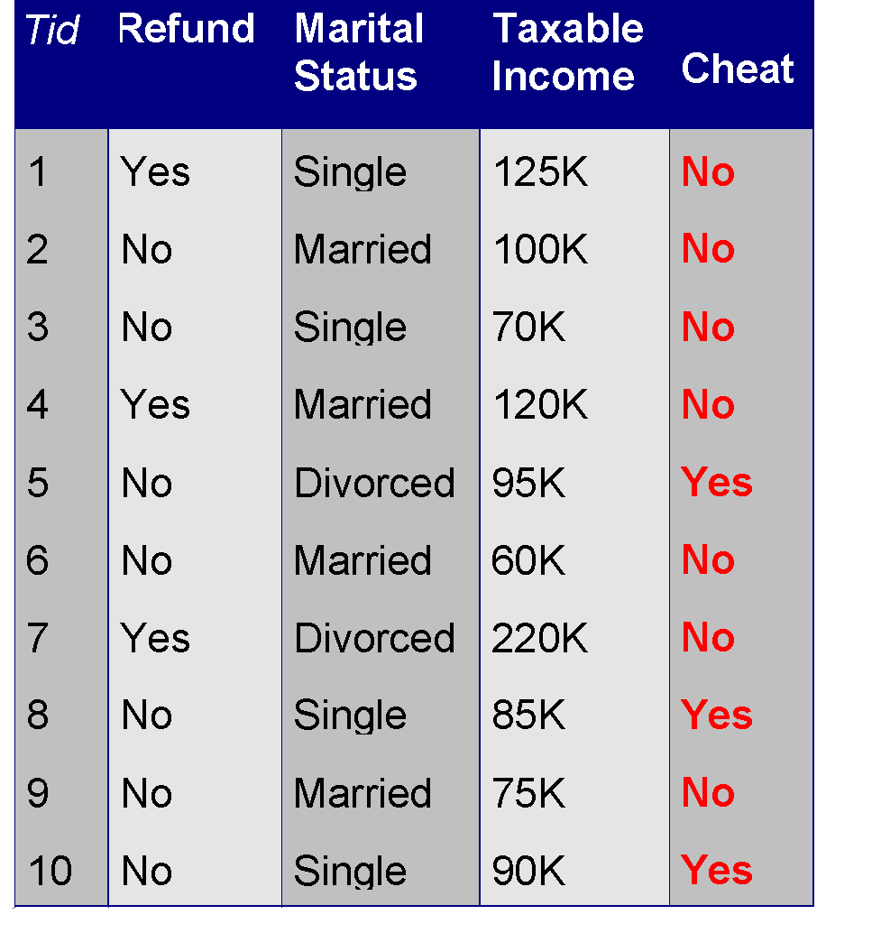
What is Data?
Collection of Data Objects and their Attributes
An attribute is a property or characteristic of an object that may vary, either from one objeect to another or from one time to another.
Examples: eye color of a person, temperature, etc.
Attribute is also known as variable, field, characteristic, dimension, or feature
A collection of attributes describe an object
Object is also known as record, point, case, sample, entity, or instance
Attributes
Objects

Slide 4
Attribute Values
Attribute values are numbers or symbols assigned to an attribute for a particular object
Distinction between attributes and attribute values
Same attribute can be mapped to different attribute values
Example: height can be measured in feet or meters
Different attributes can be mapped to the same set of values
Example: Attribute values for ID and age are integers
But properties of attribute values can be different

Slide 5
Measurement
A measurement scale is a rule (function) that associates a numerical or symbolic value with an attribute of an object.
For instance, we step on a bathroom scale to determine our weight, we classify someone as male or female, or we count the number of chairs in a room to see if there will be enough to seat all the people coming to a meeting.

Slide 6
In all these cases the "physical value" of an attribute of an object is mapped to a numerical or symbolic value.
With this background, we can now discuss the type of an attribute, a concept that is important in determining if a particular data analysis technique is consistent with a specific type of attribute.

Slide 7
Type of an attribute
The values used to represent an attribute may have properties that are not properties of the attribute itself, and vice versa
Example 1: Employee Age and ID Number
Example 2: Length of Line Segments

Slide 8
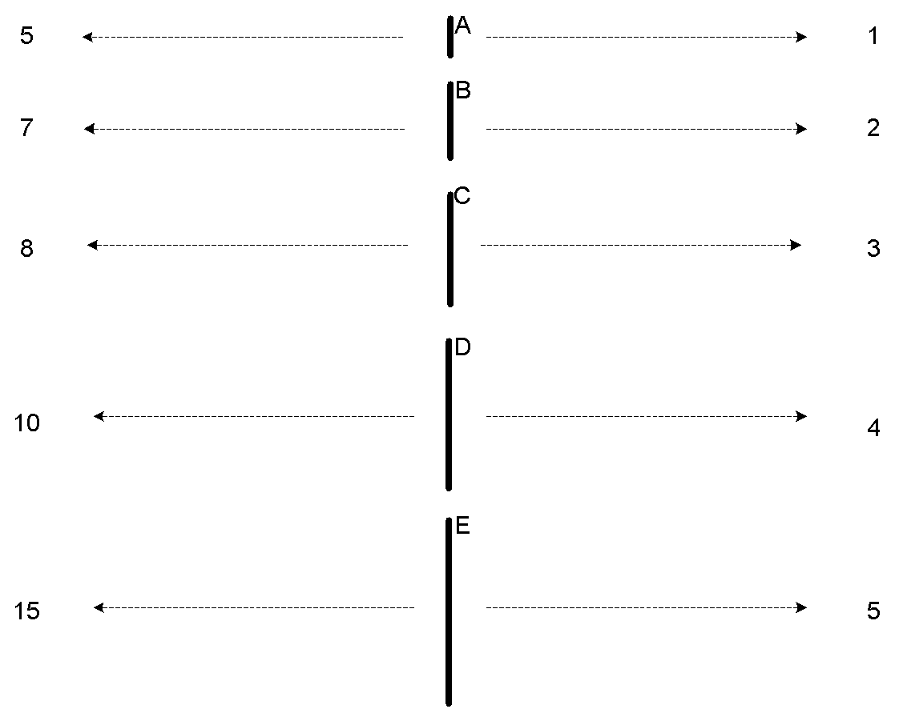
Example 2: Length of Line Segments
The way you measure an attribute may not match the attributes properties.
This scale preserves only the ordering property of length.
This scale preserves the ordering and additvity properties of length.

Slide 9
Properties of Attribute Values
The type of an attribute depends on which of the following properties/operations it possesses:
Distinctness : = and ≠
Order : < , <=, > and >=
Addition : + and -
(Meaningful Differences)
Multiplication : * and /
( Meaningful Differences)

Slide 10
Types of Attributes
There are 4 different types of attributes
Nominal
Examples: ID numbers, eye color, zip codes
Ordinal
Examples: rankings (e.g., taste of potato chips on a scale from 1-10), grades, height {tall, medium, short}
Interval
Examples: calendar dates, temperatures in Celsius or Fahrenheit.
Ratio
Examples: temperature in Kelvin, length, time, counts

Slide 11
Nominal Attribute: Nominal Attributes only provide enough attributes to differentiate between one object and another. Such as Student Roll No., Gender of the Person.
Ordinal Attribute: The ordinal attribute value provides sufficient information to order the objects. Such as Rankings, Grades, Height
Interval Scaled attribute: It is measured on a scale of equal size units, these attributes allows us to compare such as temperature in C or F and thus values of attributes have order.
Ratio Scaled attribute: Both differences and ratios are significant for Ratio. For eg. age, length, Weight.

Slide 12
Nominal attribute : distinctness
Ordinal attribute : distinctness & order
Interval attribute : distinctness, order & meaningful differences
Ratio attribute : all 4 properties/operations

Slide 13
Difference Between Ratio and Interval
Is it physically meaningful to say that a temperature of 10 ° is twice that of 5° on
the Celsius scale?
the Fahrenheit scale?
the Kelvin scale?
Consider measuring the height above average
If Bill’s height is three inches above average and Bob’s height is six inches above average, then would we say that Bob is twice as tall as Bill?
Is this situation analogous to that of temperature?

Slide 14
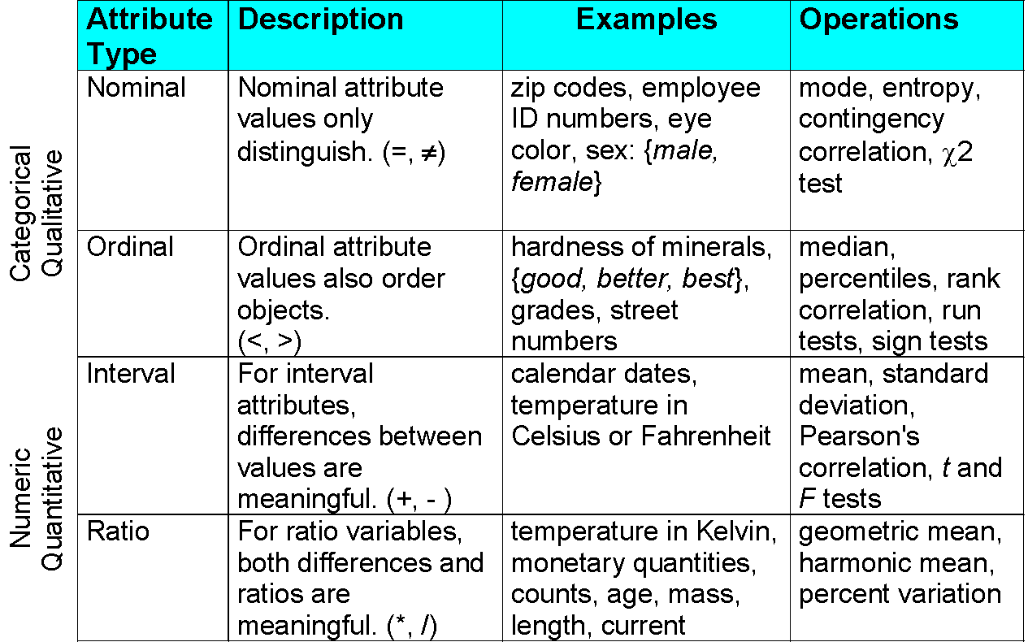

Slide 15
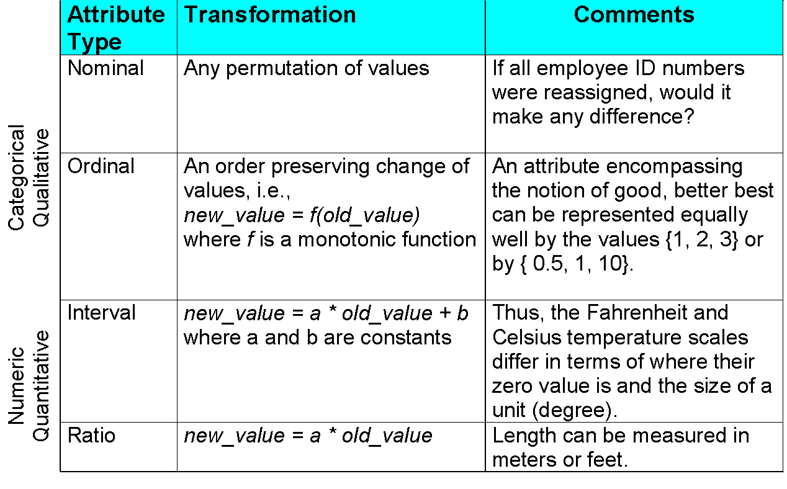

Slide 16
Discrete and Continuous Attributes
Discrete Attribute
Has only a finite or countably infinite set of values
Examples: zip codes, counts, or the set of words in a collection of documents
Often represented as integer variables.
Note: binary attributes are a special case of discrete attributes
Continuous Attribute
Has real numbers as attribute values
Examples: temperature, height, or weight.
Practically, real values can only be measured and represented using a finite number of digits.
Continuous attributes are typically represented as floating-point variables.

Slide 17
Asymmetric Attributes
Only presence (a non-zero attribute value) is regarded as important
Words present in documents
Items present in customer transactions
If we met a friend in the grocery store would we ever say the following? “I see our purchases are very similar since we didn’t buy most of the same things.”
We need two asymmetric binary attributes to represent one ordinary binary attribute
Association analysis uses asymmetric attributes
Asymmetric attributes typically arise from objects that are sets

Slide 18
Critiques …
Not a good guide for statistical analysis
May unnecessarily restrict operations and results
Statistical analysis is often approximate
Thus, for example, using interval analysis for ordinal values may be justified
Transformations are common but don’t preserve scales
Can transform data to a new scale with better statistical properties
Many statistical analyses depend only on the distribution

Slide 19
More Complicated Examples
ID numbers
Nominal, ordinal, or interval?
Number of cylinders in an automobile engine
Nominal, ordinal, or ratio?
Biased Scale
Interval or Ratio

Slide 20
Key Messages for Attribute Types
The types of operations you choose should be “meaningful” for the type of data you have
Distinctness, order, meaningful intervals, and meaningful ratios are only four properties of data
The data type you see – often numbers or strings – may not capture all the properties or may suggest properties that are not there
Analysis may depend on these other properties of the data
Many statistical analyses depend only on the distribution
Many times what is meaningful is measured by statistical significance
But in the end, what is meaningful is measured by the domain

Slide 21
Types of data sets
Record
Data Matrix
Document Data
Transaction Data
Graph
World Wide Web
Molecular Structures
Ordered
Spatial Data
Temporal Data
Sequential Data
Genetic Sequence Data

Slide 22
Important Characteristics of Data
Dimensionality (number of attributes)
High dimensional data brings a number of challenges
Sparsity
Only presence counts
Resolution
Patterns depend on the scale
Size
Type of analysis may depend on size of data

Slide 23

Record Data
Data that consists of a collection of records, each of which consists of a fixed set of attributes

Slide 24
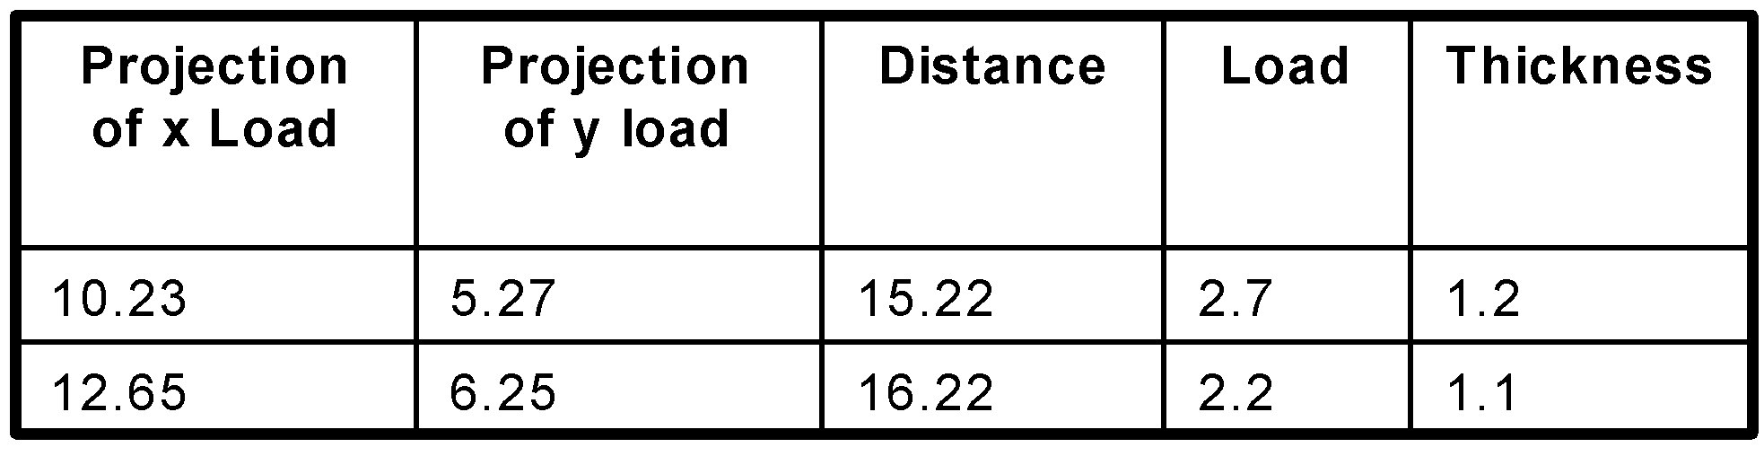
Data Matrix
If data objects have the same fixed set of numeric attributes, then the data objects can be thought of as points in a multi-dimensional space, where each dimension represents a distinct attribute
Such data set can be represented by an m by n matrix, where there are m rows, one for each object, and n columns, one for each attribute

Slide 25
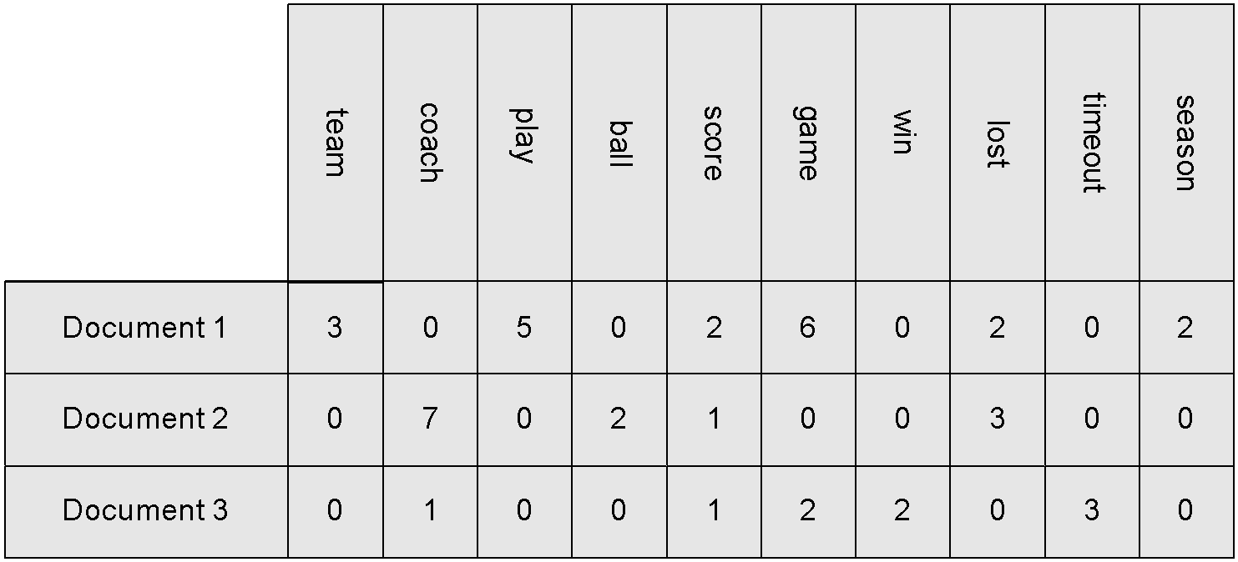
Document Data
Each document becomes a ‘term’ vector
Each term is a component (attribute) of the vector
The value of each component is the number of times the corresponding term occurs in the document.

Slide 26
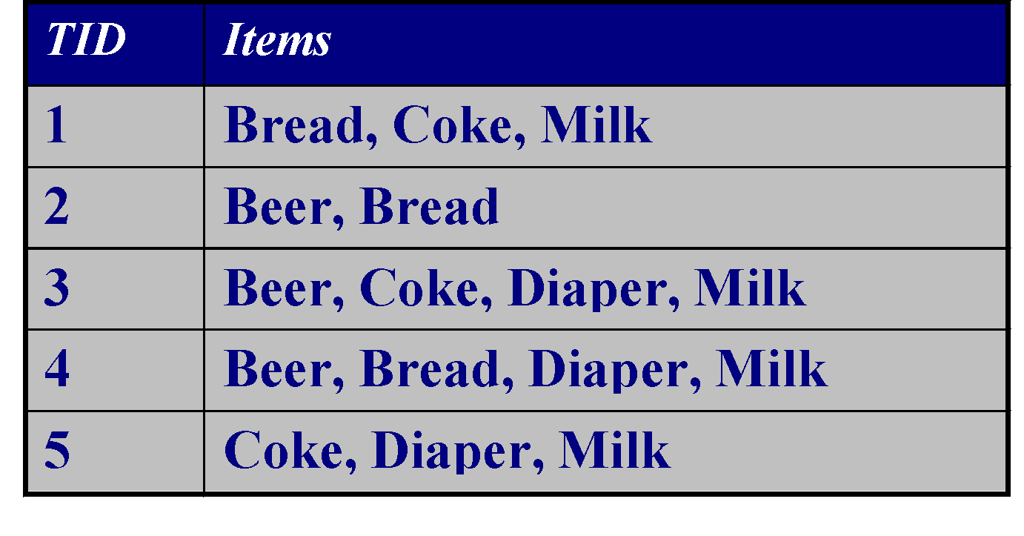
Transaction Data
A special type of record data, where
Each record (transaction) involves a set of items.
For example, consider a grocery store. The set of products purchased by a customer during one shopping trip constitute a transaction, while the individual products that were purchased are the items.

Slide 27
Graph Based Data
1, Data with Relationships among objects
ex: Web pages
2, Data with Objects that are Graphs
ex: Molecule

Slide 28
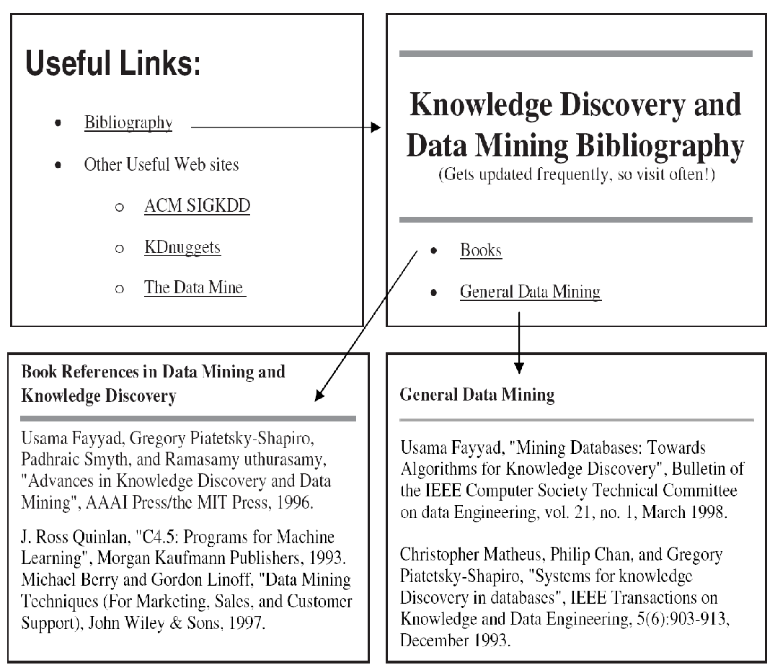
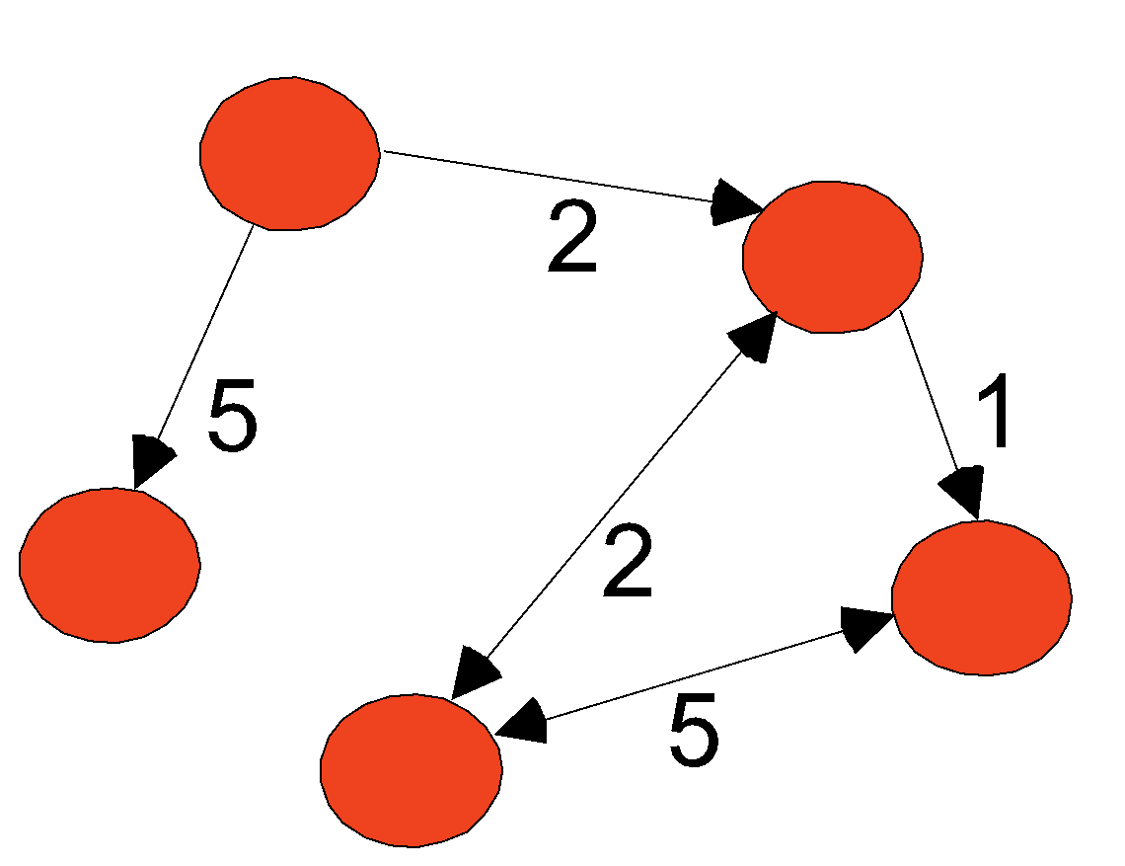
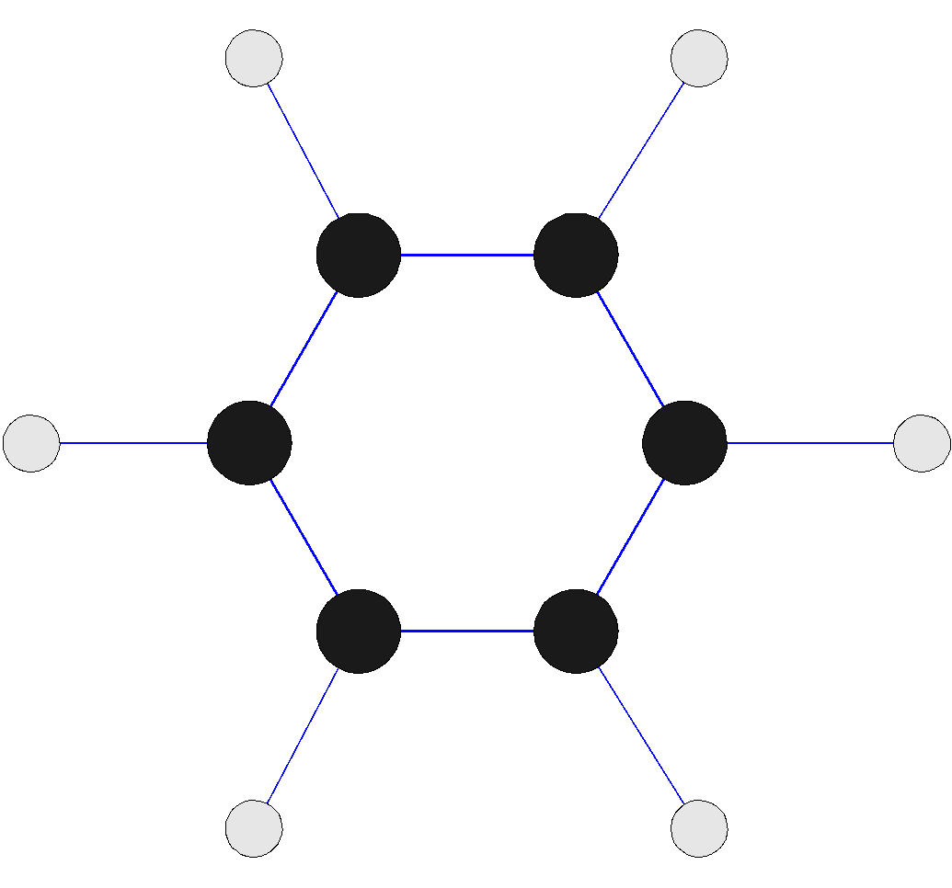
Graph Data
Examples: Generic graph, a molecule, and webpages
Benzene Molecule: C6H6

Slide 29
Ordered Data
Sequential Data
Sequence Data
Time Series Data
Spatial Data

Slide 30
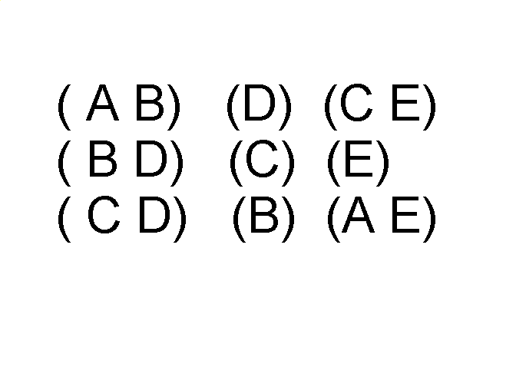
Ordered Data
Sequential Data : Also referred as temporal data
Sequences of transactions
An element of the sequence

Slide 31
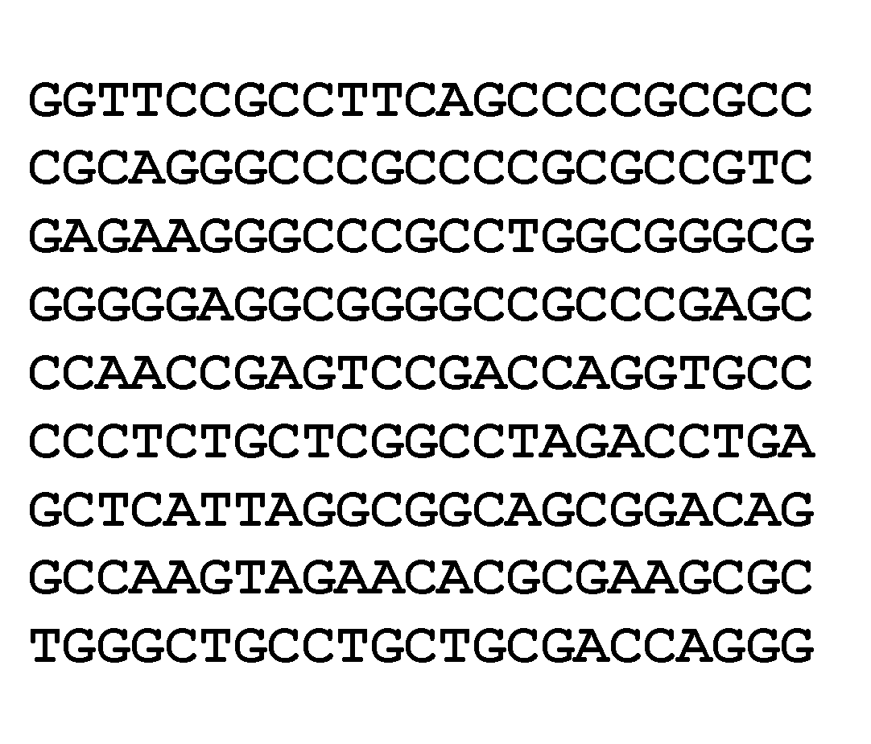
Ordered Data
Sequence Data: Ex: Genome sequencing

Slide 32
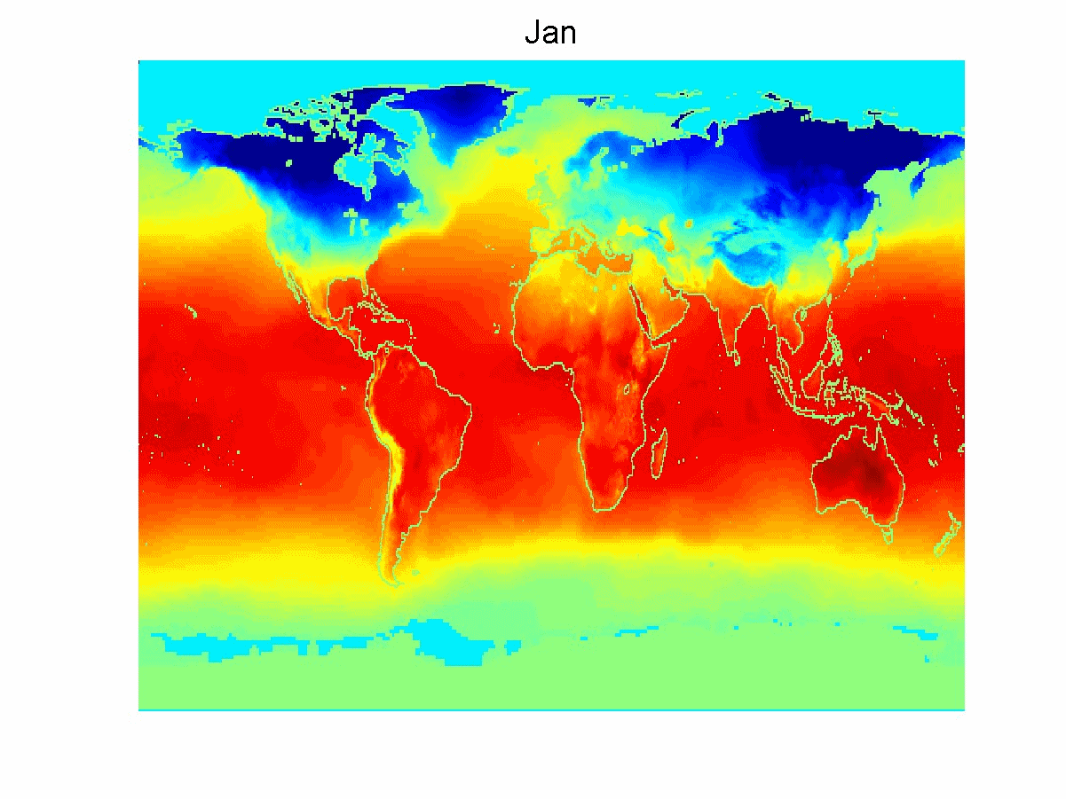
Ordered Data
Spatio-Temporal Data
Average Monthly Temperature of land and ocean

Slide 33
Data Quality
Poor data quality negatively affects many data processing efforts
“The most important point is that poor data quality is an unfolding disaster.
Poor data quality costs the typical company at least ten percent (10%) of revenue; twenty percent (20%) is probably a better estimate.”
Thomas C. Redman, DM Review, August 2004
Data mining example: a classification model for detecting people who are loan risks is built using poor data
Some credit-worthy candidates are denied loans
More loans are given to individuals that default

Slide 34
Data Quality …
What kinds of data quality problems?
How can we detect problems with the data?
What can we do about these problems?
Examples of data quality problems:
Noise and outliers
Missing values
Duplicate data
Wrong data

Slide 35
Measurement and Data Collection Errors
The term Measurement Error refers to any problem resulting from the measurement process.
A common problem is that the value recorded differs from the true value to some extent.
For continuous attributes, the numerical difference of the measured and true value is called the error.
The term Data Collection Error refers to errors such as omitting data objects or attribute values, or inappropriately including a data object.
For example, a study of animals of a certain species might include animals of a related species that are similar in appearance to the species of interest.

Slide 36
Noise and Artifacts
Noise is the random component of a measurement error. It may involve the distortion of a value or the addition of spurious objects.
The term noise is often used in connection with data that has a spatial or temporal component.
In such cases, techniques from signal or image processing can frequently be used to reduce noise and thus, help to discover patterns (signals) that might be "lost in the noise."
Nonetheless, the elimination of noise is frequently difficult, and much work in data mining focuses on devising robust algorithms that produce acceptable results even when noise is present.

Slide 37
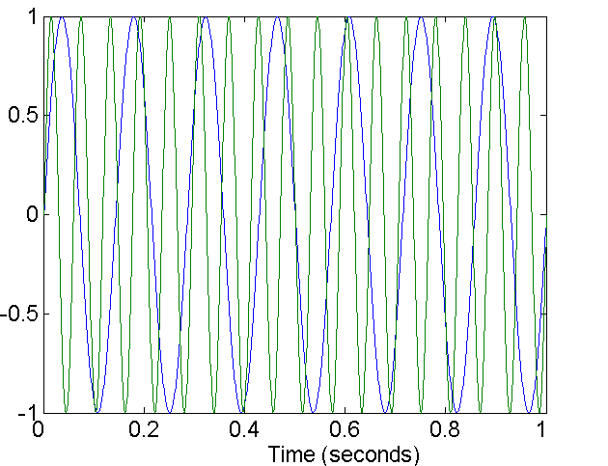
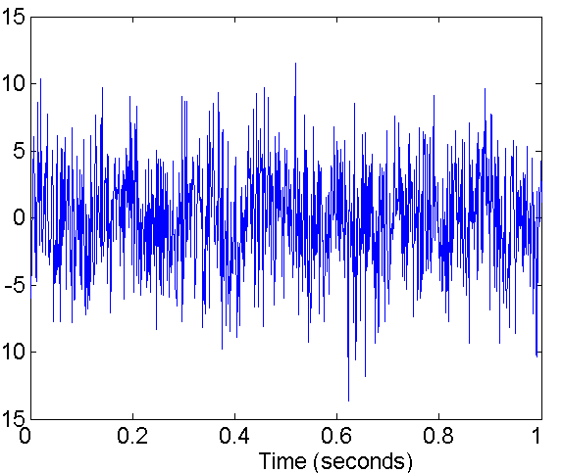
Noise
For objects, noise is an extraneous object
For attributes, noise refers to modification of original values
Examples: distortion of a person’s voice when talking on a poor phone and “snow” on television screen
Two Sine Waves
Two Sine Waves + Noise

Slide 38
Data errors may be the result of a more deterministic phenomenon, such as a streak in the same place on a set of photographs. Such deterministic distortions of the data are often referred to as artifacts.
A data artifact is a data flaw caused by equipment, techniques or conditions.
Common sources of data flaws include hardware or software errors, conditions such as electromagnetic interference and flawed designs such as an algorithm prone to miscalculations

Slide 39
Precision, Bias, and Accuracy
Precision: The closeness of repeated measurements (of the same quantity) to one another.
Precision is often measured by the standard deviation of a set of values
Bias: A systematic quantity being measured.
Bias is measured by taking the difference between the mean of the set of values and the known value of the quantity being measured.
Bias can only be determined for objects whose measured quantity is known by means external to the current situation

Slide 40
For example: Suppose that we have a standard laboratory weight with a mass of 1g and want to assess the precision and bias of our new laboratory scale.
We weigh the mass five times, and obtain the following five values: {1.015,0.990, 1.013, 1.001,0.986}.
The mean of these values is 1.001, and hence, the bias is 0.001. The precision, as measured by the standard deviation, is 0.013.
Accuracy: The closeness of measurements to the true value of the quantity being measured.
Accuracy depends on precision and bias, but since it is a general concept, there is no specific formula for accuracy in terms of these two quantities

Slide 41
Outliers
Outliers are either (1) data objects that, in some sense, have characteristics that are different from most of the other data objects in the data set, or (2) values of an attribute that are unusual with respect to the typical values for that attribute.
It is important to distinguish between the notions of noise and outliers.
Outliers can be legitimate data objects or values. Thus, unlike noise, outliers may sometimes be of interest.
In fraud and network intrusion detection, for example, the goal is to find unusual objects or events from among a large number of normal ones.

Slide 42
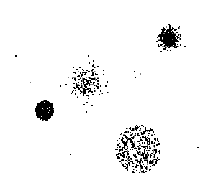
Outliers
Outliers are data objects with characteristics that are considerably different than most of the other data objects in the data set
Case 1: Outliers are noise that interferes with data analysis
Case 2: Outliers are the goal of our analysis
Credit card fraud
Intrusion detection
Causes?

Slide 43
Missing Values
It is not unusual for an object to be missing one or more attribute values.
In some cases, the information was not collected; e.g., some people decline to give their age or weight.
In other cases, some attributes are not applicable to all objects; e.g., often, forms have conditional parts that are filled out only when a person answers a previous question in a certain way, but for simplicity, all fields are stored.
Regardless, missing values should be taken into account during the data analysis.

Slide 44
Eliminate Data Objects or Attributes
A simple and effective strategy is to eliminate objects with missing values.
However, even a partially specified data object contains some information, and if many objects have missing values, then a reliable analysis can be difficult or impossible.
Nonetheless, if a data set has only a few objects that have missing values, then it may be expedient to omit them.
A related strategy is to eliminate attributes that have missing values. This should be done with caution, however, since the eliminated attributes may be the ones that are critical to the analysis.

Slide 45
Estimate Missing Values
Sometimes missing data can be reliably estimated.
For example, consider a time series that changes in a reasonably smooth fashion, but has a few, widely scattered missing values.
In such cases, the missing values can be estimated (interpolated) by using the remaining values.
As another example, consider a data set that has many similar data points. In this situation, the attribute values of the points closest to the point with the missing value are often used to estimate the missing value.

Slide 46
If the attribute is continuous, then the average attribute value of the nearest neighbors is used.
If the attribute is categorical, then the most commonly occurring attribute value can be taken.
For a concrete illustration, consider precipitation measurements that are recorded by ground stations. For areas not containing a ground station, the precipitation can be estimated using values observed at nearby ground stations..

Slide 47
Inconsistent Values
Data can contain inconsistent values. Consider an address field, where both a zip code and city are listed, but the specified zip code area is not contained in that city.
It may be that the individual entering this information transposed two digits, or perhaps a digit was misread when the information was scanned from a handwritten form.
Some types of inconsistencies are easy to detect. For instance, a person's height should not be negative.
In other cases, it can be necessary to consult an external source of information.

Slide 48
For example, when an insurance company processes claims for reimbursement, it checks the names and addresses on the reimbursement forms against a database of its customers.
A product code may have "check" digits, or it may be possible to double-check a product code against a list of known product codes, and then correct the code if it is incorrect, but close to a known code. The correction of an inconsistency requires additional or redundant information.

Slide 49
Duplicate Data
A data set may include data objects that are duplicates, or almost duplicates, of one another.
Many people receive duplicate mailings because they appear in a database multiple times under slightly different names.
To detect and eliminate such duplicates, two main issues must be addressed.
First, if there are two objects that actually represent a single object, then the values of corresponding attributes may differ, and these inconsistent values must be resolved.

Slide 50
Second, care needs to be taken to avoid accidentally combining data objects that are similar, but not duplicates, such as two distinct people with identical names.
In some cases, two or more objects are identical with respect to the attributes measured by the database, but they still represent different objects.
Here, the duplicates are legitimate, but may still cause problems for some algorithms if the possibility of identical objects is not specifically accounted for in their design

